Slide 1
How can computer networks be improved and how can they be secured more efficiently?
Trina Roy
Notes:
Hello everyone! I am Trina Roy and I am going to talk about network security. I chose this topic for the sole reason that I wanted to know how to secure our data much more efficiently. Before I go any further, I would like you to ask you some questions.

Slide 2
What is network security?
What do you think is good network security?
How many of you have experienced a security breach while using any of your devices?
Notes:
ASK QUESTION TO AUDIENCE: What do you think is good network security?
ASK QUESTION TO AUDIENCE: How many of you have experienced a security breach while using any of your devices?
Variety of answers

Slide 3
What is network security?
Network security is protection of the access to files and directories in a computer network against hacking, misuse and unauthorized changes to the system.
A computer network is a group of computer or terminals such as workstations, linked together by network cabling or by wireless links.
What is security?
Security can be defined as the “freedom from danger, risk, ; safety.”
Notes:
Network security is an exciting field which requires you to understand that the information that we share is not always secured efficiently, for the sole reason that our technologies are not developed enough and there are not enough people who can handle this kind of job, simply because there aren’t any. I would like to be in that area. This will help me getting towards my target of becoming a computer scientist.

Slide 4
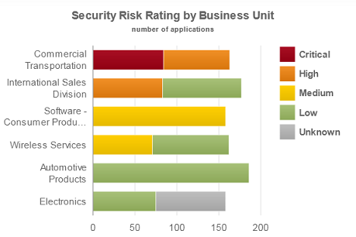
Why do we need this?
Notes:
“Security is now a basic requirement because global computing is inherently secure.” - Taken from TYBSC – IT NETWORK SECURITY
Thousands of businesses rely on the transfer of data and information between each other and no business, especially banks, have to take extra and more special care while processing and securing that information. After all, it’s our money in there! As you can see in the chart, the commercial transportation has the highest risk of having a security breach.

Slide 5
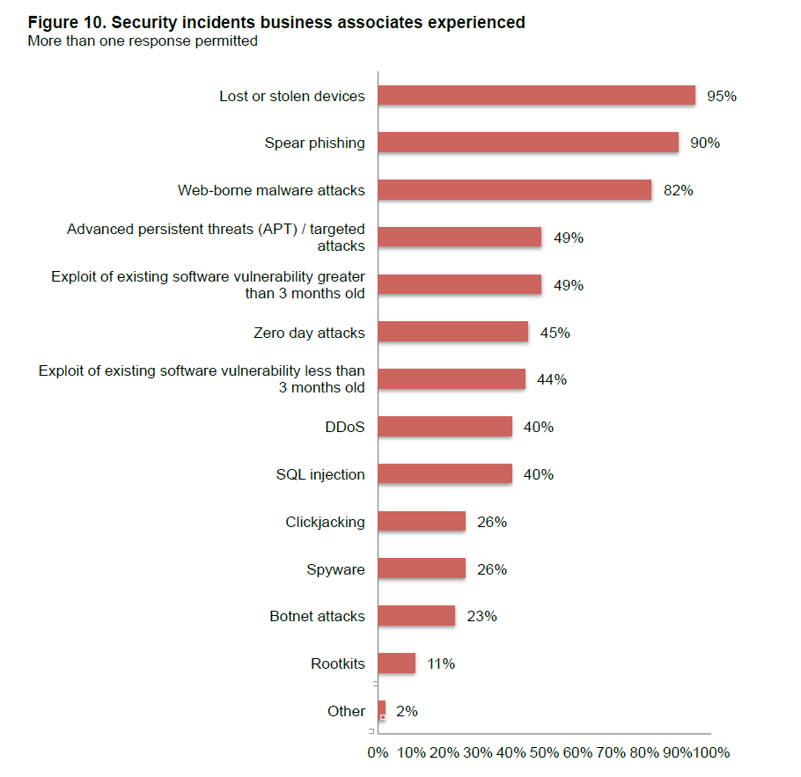
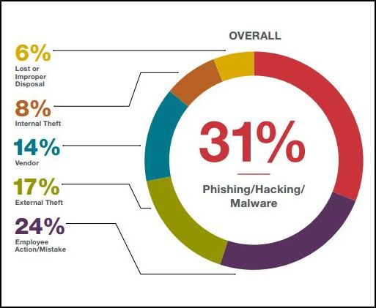
Why do we need this?
Notes:
The picture at the left shows the types of security breaches that businesses have received. As you can see, “Lost or stolen devices ”, being at 95% is the highest.
Spear phishing is an e-mail spoofing fraud attempt that targets a specific organization, seeking unauthorized access to confidential data. - http://searchsecurity.techtarget.com/definition/spear-phishing
A zero-day threat is a threat that exploits an unknown computer security vulnerability. The term is derived from the age of the exploit, which takes place before or on the first (or “zeroth”) day of a developer’s awareness of the exploit or bug. This means that there is no known security fix because developers are oblivious to the vulnerability or threat. - https://www.techopedia.com/definition/27451/zero-day-threat – 05/12/16
Distributed Denial of Service – it a type of DOS where multiple compromised systems, which are infected by a Trojan, are used a single system causing a Denial of Service.- http://www.webopedia.com/TERM/D/DDoS_attack.html – 05/12/16
SQL injection is a code injection technique, used to attack data – driven apps, in which SQL statements into an entry field for execution. – Wikipedia, 2016, SQL injection [online] Available at: <https://en.Wikipedia.org/wiki/SQL_injection> [Accessed 07/12/16]
Botnet is a network of private computer infected with malicious software and controlled as a group without the owners’ knowledge e.g. to send spam – Google – 07/12/16

Slide 6
Details of my report
In my dissertation I am currently researching about the need for the network security in homes and businesses
Why do you think you need it?
Homes: Stop identity fraud
Business: Looking after customers and clients’ personal details
Now I will give details of my report plan in relation to what I am interested

Slide 7
Details of my report plan
This is my plan
The part that I am most interested is the Cryptography section
It includes:
Plain and cipher text
Substitution techniques
Caesar cipher
Polyalphabetic substitution
Hill cipher
Mono – alphabetic cipher
Transposition techniques
Rail – fence technique
Encryption and decryption
Symmetric Key and Asymmetric Key
Steganography

Slide 8
Symmetric Key
Key (K)
Plaintext (P)
Encrypt (E)
Ciphertext (C)
C = EK (P)
Same Key (K)
Ciphertext (C)
Decrypt (D)
Plaintext (P)
P = DK (C)
P = DK (EK (P))

Slide 9
Conclusion
The need for an improved network security is really important for a better online experience
It gave me the insight of the possible ways we can counterattack the hacker, but also the problems with the current technologies that we use to protect ourselves and our information and the security in itself.
It also crucial that people understand the fact that there is a link between security, practicality and cost. An example could be there is the best possible way to secure the data, but the downsides are that this is expensive and can only be used for technicians or people who have expertise in the field.

Slide 10
Reflection
What went well?
Research for the topics that I was interested in, which is going to help me for university study.
Gained and/ or improved skills in:
Criticise a source and give explanation the reason why I am including or not in my reference list
Being able to reference documents, reports, presentations
Being able to speak to an audience (improve my confidence)
Being selective about the area I wanted to research
Practice to write reports
Study independently
Changes that I would want to make if I had to do it again?
Time management
I would possibly focus on one aspect on how to secure the data like cryptography.
Would try to make sure that the report gets the required time to develop
Notes:
As you have seen by my plan, the topic of network security is quite broad. It was hard for me to understand how I should make it a more – focused report, so…..

Slide 11
Any questions?

Slide 12
Sources for SLIDE 3:
Definition of computer network - Administrator, 2013. AS Notes – Networks. [PowerPoint Presentation] AS Notes – Networks. Networks module. The Billericay School, Information and Communication Technology Department Available at: L:\Computer Science\A Key Stage 5\WJEC IT A Level\AS Level\WJEC Unit 1 Information Systems\Theory\1.8 Networks [Accessed 12/07/2016]
Definition of security – Dictionary.com, 2016, Security [online] Available at: <http://www.dictionary.com/browse/security> [Accessed 01/12/16]
Definition of network security – YourDictionary, 2016, Network Security [online] Available at: <http://www.yourdictionary.com/network-security> [Accessed 01/12/2016]
Figure 1 – Securityintelligence, 2016, Implementing Risk – Based Application Security Management at Your Organization [online] Available at: https://securityintelligence.com/application-security-management-ibm-appscan-enterprise-9/ [Accessed 02/12/16]
Figure 2 – Scmagazine, 2016, Fifth Annual Benchmark Study on Privacy & Security OF Healthcare Data [online] Available at: <https://media.scmagazine.com/documents/121/healthcare_privacy_security_be_30019.pdf> [Accessed 07/12/16]
Figure 3 – PropertyCasualty360, 2016, What are the leading causes of data security [online] Available at: <http://www.propertycasualty360.com/2016/04/12/what-are-the-leading-causes-of-data-security-breac> [Accessed 07/12/16]

